Slide 1
How to Solve Pseudo Codes
Quickly & Correctly

Slide 2
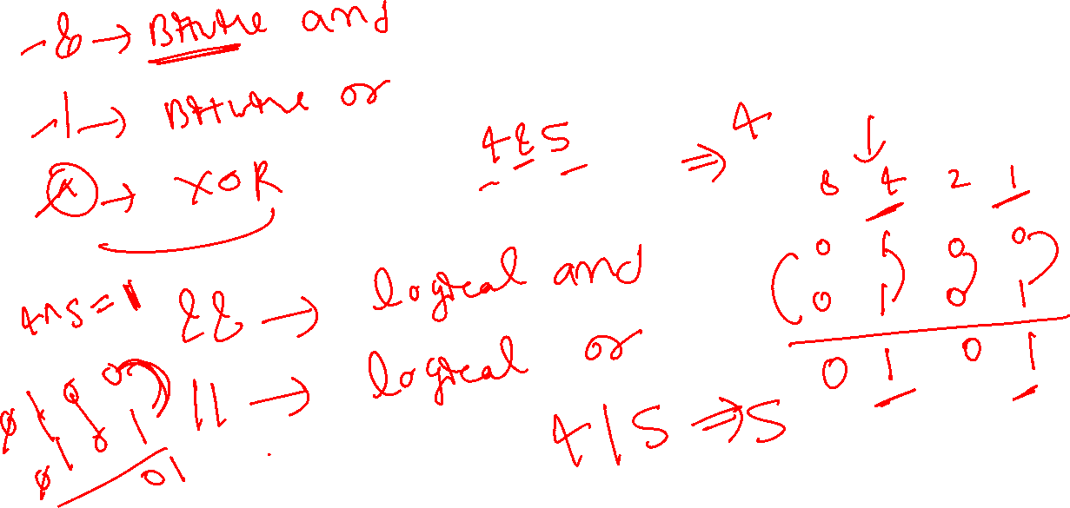

Slide 3
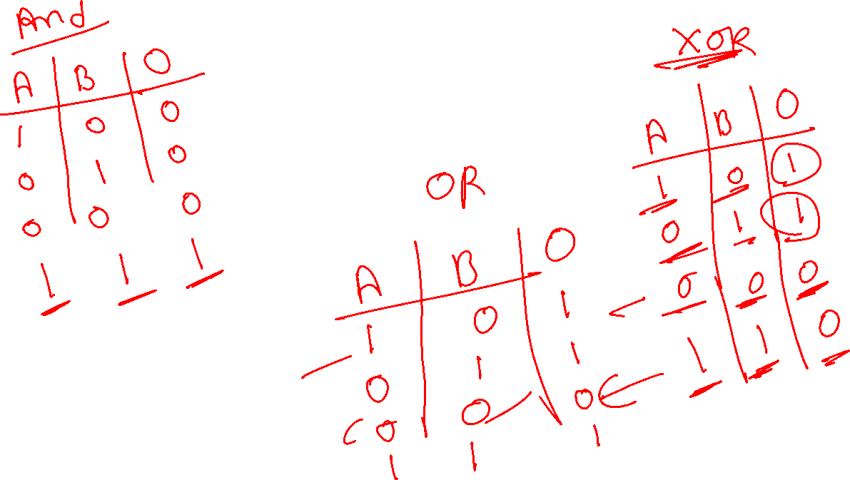

Slide 4
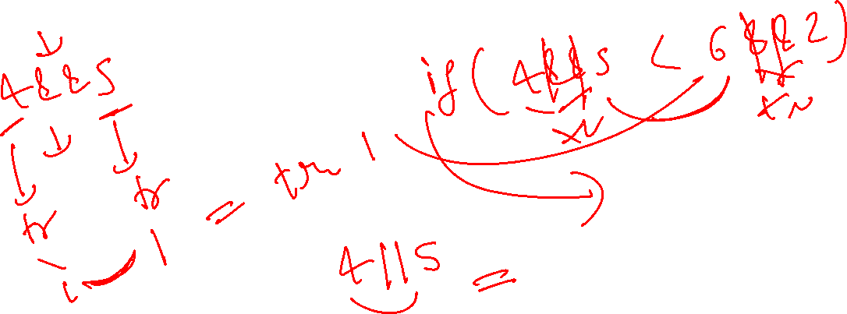

Slide 5
